Slide 1

NETFLIX MOVIES AND TV SHOWS
Group Project: A Comprehensive Analysis of Netflix Titles

Slide 2

AGENDA
Agenda
Description
Overview of the Dataset
Scope of Analysis
Unveiling Patterns
Conclusion
Navigating the Chapters of Insight

Slide 3

INTRODUCTION
Netflix: A Brief Description
Origins and Evolution
Content Revolution
Global Reach
Why this dataset?
Why this dataset?

Slide 4

DATASET OVERVIEW
Description
This dataset consists of 12 key columns which captures the multifaceted aspects of TV and Movies added onto Netflix each year. This tabular dataset consists of listings and details such as-
Cast
Ratings
Release year
Duration
Type
Show ID
Unveiling the Data Landscape

Slide 5
SCOPE OF ANALYSIS
DRIVING QUESTION

Slide 6
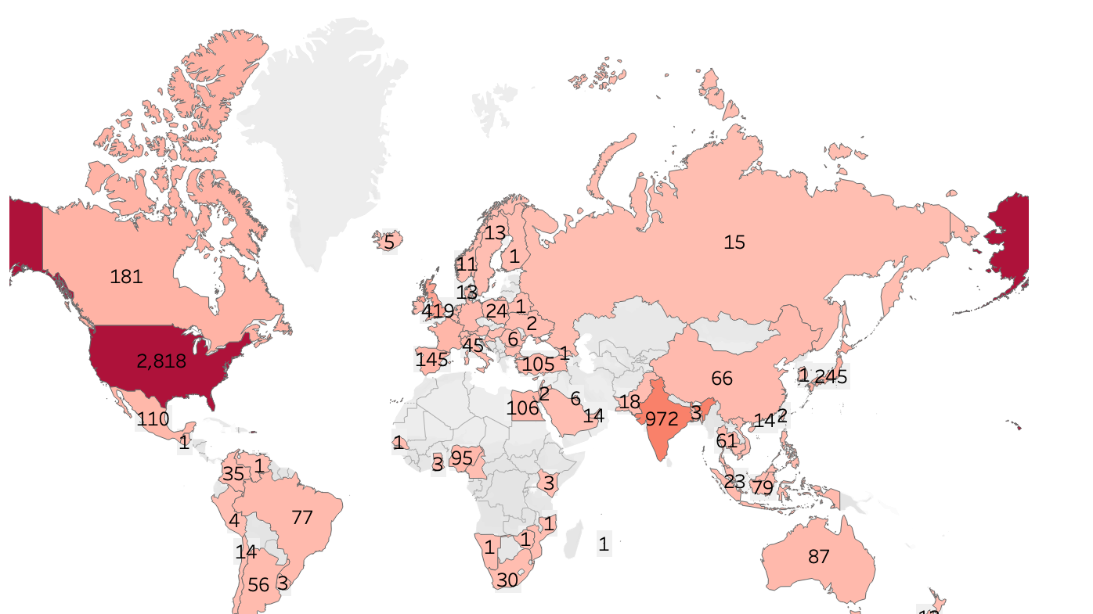
UNVEILING PATTERNS
Total MOVIES AND TV SHOWS BY COUNTRY

Slide 7
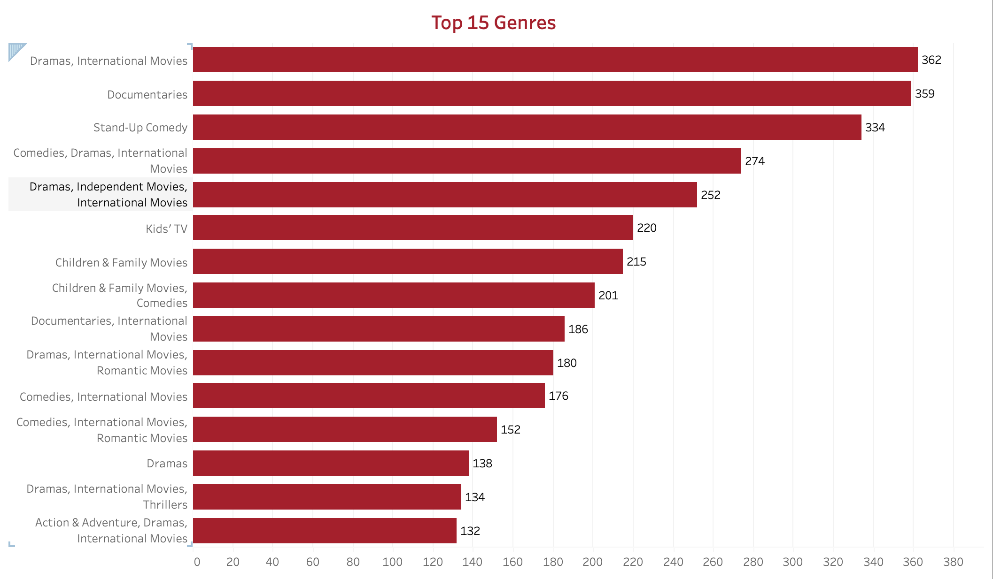
UNVEILING PATTERNS
TOP 15 GENRES of netflix

Slide 8
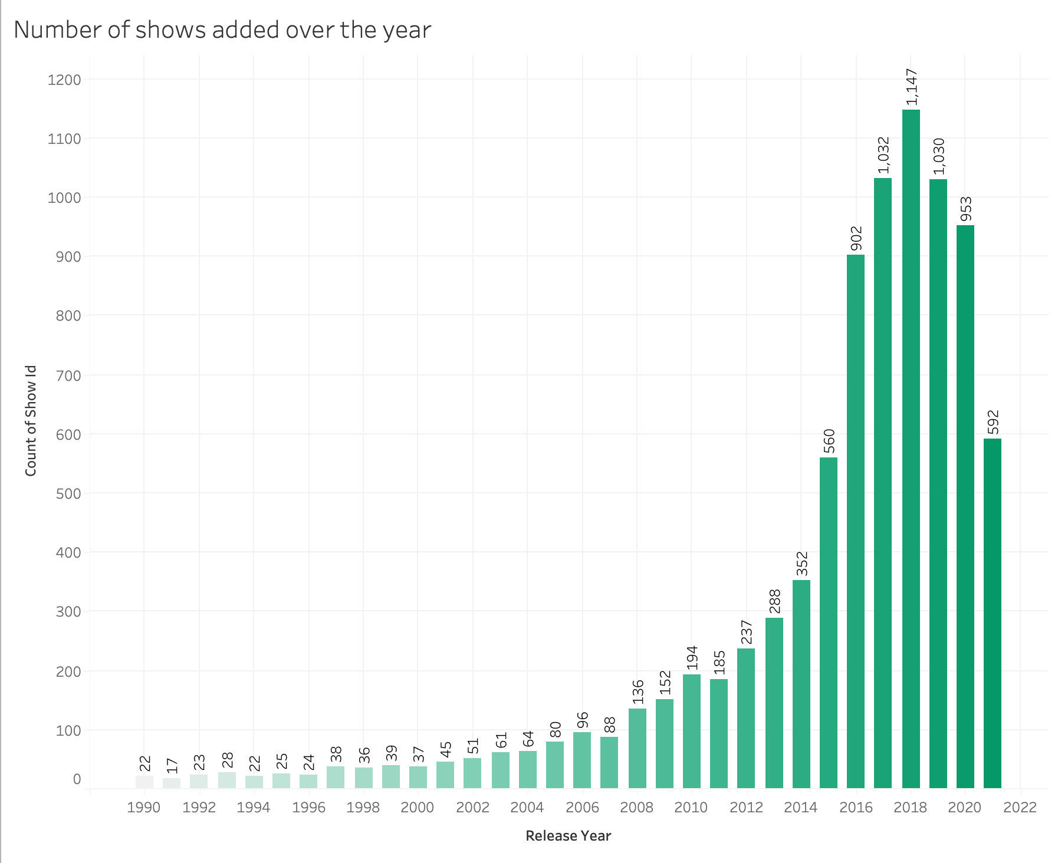
Number of Netflix Shows Released Year-Wise
Year-wise Shows

Slide 9
Netflix substantial growth in its content offering
The Year 2018 Marked A Pinnacle, Witnessing The Highest Number of Show Releases.
Following Closely, 2017 Maintained This Momentum With A Diverse array Of Captivating Shows.
In 2019, The Trend Continued, With A Robust Lineup Of New releases.
Despite Global Challenges In 2020, Netflix Remained Steadfast In delivering Fresh And Engaging Content.
However, In 2021, There Was A Notable Decrease In The Number of Shows Released, Indicating A Potential Shift In Content Strategy.
As We Look Back To 2016, The Foundation Was Laid For Netflix's Expansive Content Library.

Slide 10
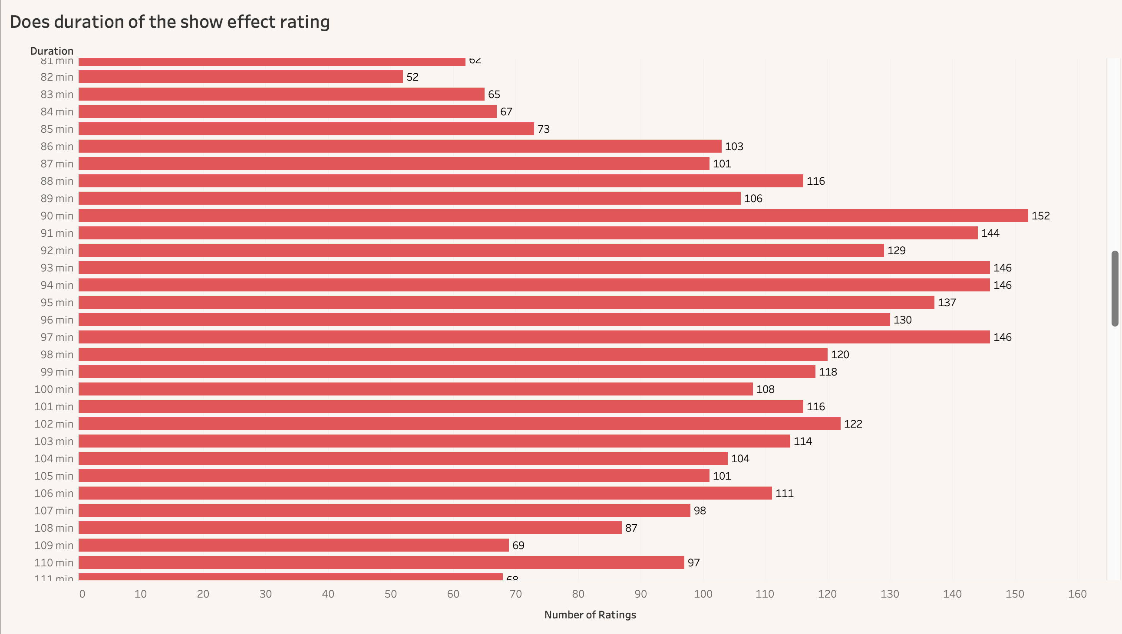
Exploring the Relationship: Duration of Show vs Rating
Decoding Impact: Duration's Influence on Ratings

Slide 11
Analyzing the Impact of Duration on number of ratings
Our analysis reveals a fascinating correlation between the duration of videos and the number of ratings they receive.
Notably, videos more than 70 – 90 minutes consistently garner the highest number of ratings, indicating a sweet spot for viewer engagement.Also video with more than 100 minutes has got less number of reviews compared to the other
On the contrary, videos with durations below 25 minutes show comparatively lower ratings, suggesting potential room for improvement in capturing audience attention.
Understanding this relationship allows for strategic content planning, ensuring optimal engagement based on video duration.

Slide 12

The Evolution of Netflix Entertainment: Analyzing Dynamic Ratings Trends for Shows and Movies Over Time

Slide 13
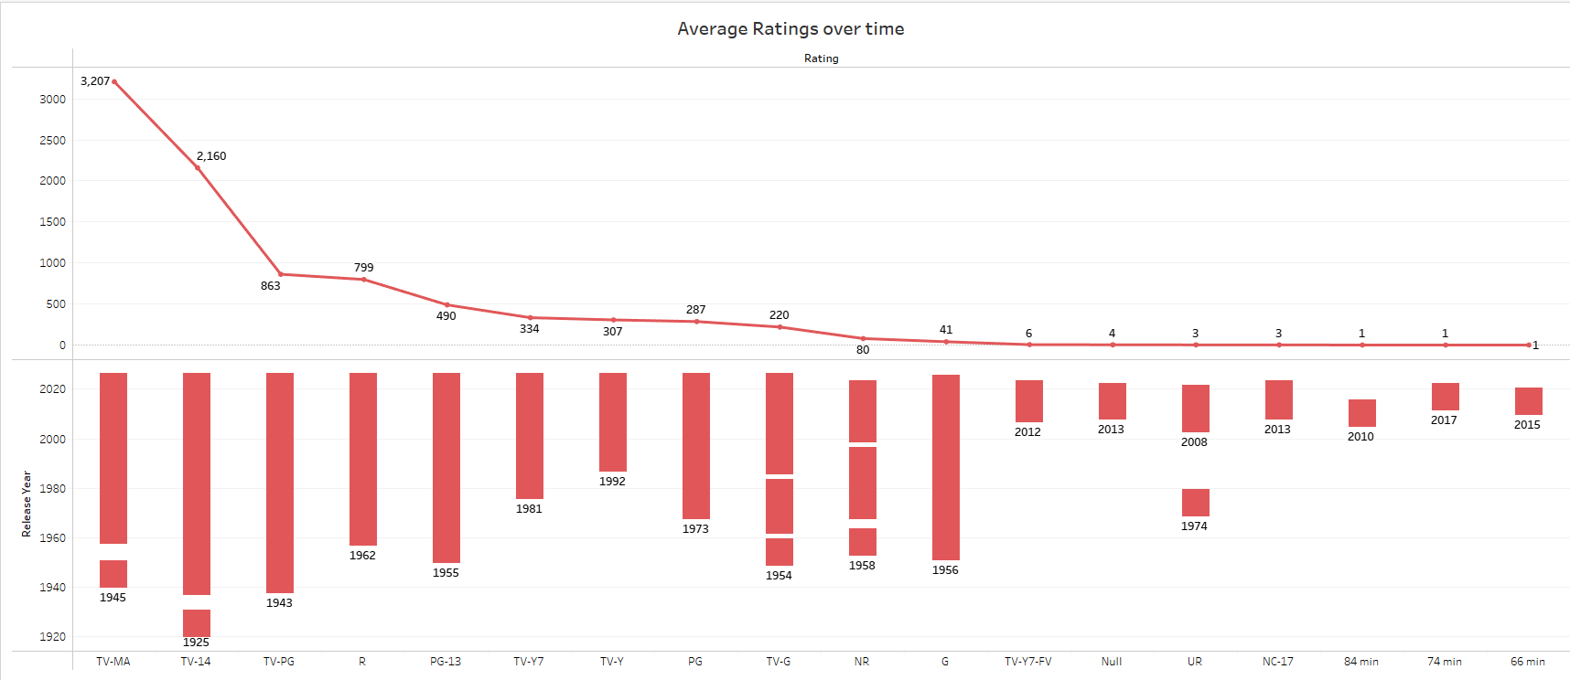

Slide 14

conclusion

Slide 15

Thank you!

